Slide 1
RESEARCH ON MACROECONOMIC TRENDS, DATA, AND FOREIGN TRADE FOR THE 10 YEARS
Your Name
ECO 202
Instructor Name
Notes:
Choose a title for your presentation.
Include your name, the course name and the assignment name.

Slide 2
Ten-Year Period of U.S. Economic History Overview
Assessing an economic outlook of a nation hinges on series of National Income Accounting analyses
The key analyses focuses on Gross Domestic Product , Unemployment Rate , Inflation , and Government Policies
The above macroeconomic indicators are critical because they influence the living standards and accord a particular country fundamental competitiveness in an international commerce
The most integral timeframe to evaluate changes in the four macroeconomic indicators for the United States is period 1950 to 1960
The Decade of Prosperity with an average 37% growth rate in GDP
Distinctive events:-
Eisenhower's Economic Stimulus Programs
Post-Second World War
Notes:
The inflationary stresses experienced in Post World War period had negative effects on the Gross Domestic Product (GDP), increased unemployment rate, and high inflation indices (Melvin & Norrbin, 2013). Importantly, the National Income Accounting is an important economic analysis that provides an outlook about the general trends in an economy because it facilitates the economic decision-makers depict the prevailing trends. The profound national income analyses focus on the GDP, which provides the market value of the entire goods and services produced in a country for a particular period.
An alternative model that enhances an economic outlook of a country relates to the prevailing Unemployment and Inflation Rates
similarly, the unemployment and inflation rates are integral indicators of the national income for an economy because they influence the growth capabilities. Notably, the prevailing unemployment and inflation rates influence the calibers of government policies to alleviate the citizens against adverse economic parameters. The U.S. government agencies resolved to integrate expansionary fiscal policies and contractionary monetary schemes to address the financial stresses. Besides, the choice of the government policies to address the prevailing economic conditions is a strategic process to improve the living standard of the citizens.

Slide 3
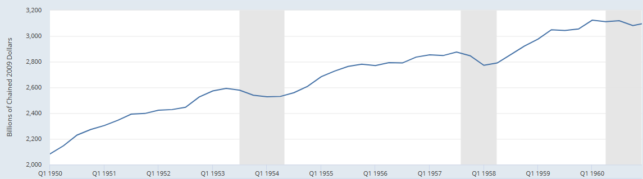
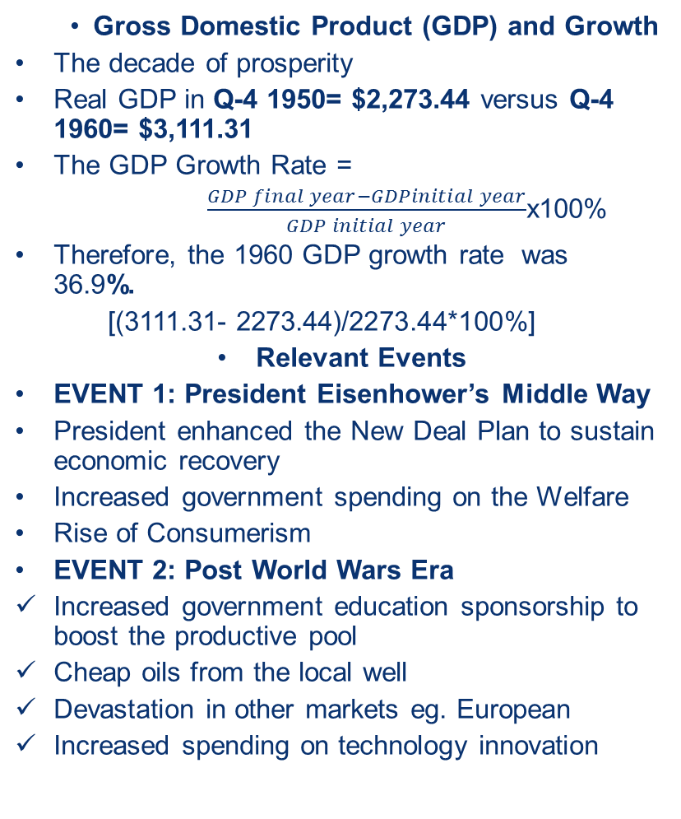
Gross Domestic Product and Growth (2 slides)
  Gross Domestic Product (GDP) and Growth
    The decade of prosperity
    Real GDP in Q-4 1950= $2,273.44 versus Q-4 1960= $3,111.31
    The GDP Growth Rate =
    $\frac{GDP final year−GDPinitial year}{GDP initial year}$x100%
    Therefore, the 1960 GDP growth rate was 36.9%.
    [(3111.31- 2273.44)/2273.44*100%]
    Relevant Events
    EVENT 1: President Eisenhower’s Middle Way
    President enhanced the New Deal Plan to sustain economic recovery
    Increased government spending on the Welfare
    Rise of Consumerism
    EVENT 2: Post World Wars Era
    Increased government education sponsorship to boost the productive pool
    Cheap oils from the local well
    Devastation in other markets eg. European
    Increased spending on technology innovation
Real GDP Growth of the United States from 2007-2017
Notes:
The U.S has experienced an overall positive trends in the real GDP growth over the past 10 years because of the effective fiscal and monetary policies. The onset of the decade was apparent by a detrimental inflationary stresses because of the negative post World War Phenomenon, which altered the production routines across the globe. The real GDP output in 1950 was the decade-low because the aggregate market value for the entire U.S. production was hampered by negative geo-political parameters. However, President Eisenhower adopted numerous stimulus programs to harness productivity across the country. Specifically, increased government spending using large larger projects and expanding the number of the Americans enrolled to the Social Security had positive outcomes because the GDP Growth rose to 37% in 1960.
The impacts of the Post World War and President Eisenhower’s economic stimulus programs can be illustrated using the GDP formula. First, Post World War era experienced in 1950 reduced consumption and disrupted normal production activities, which negatively affects the key components of national income. On the other hand, expansionary strategies have positive effects on the components of the national income. Notably, increased government spending, increased wage rates, and rise of consumerism have incremental effects on the four components of GDP.
The economists compute the GDP of a particular economy by combining multiple factors using the formula:
GDP formula (E)= C+I+G+(X-M), where ‘C’ represents total consumption, ‘I’ reveals spending on investment, ‘G’ depict the government spending into the economy, and ‘X-M’ is a country’s balance of trade.

Slide 4
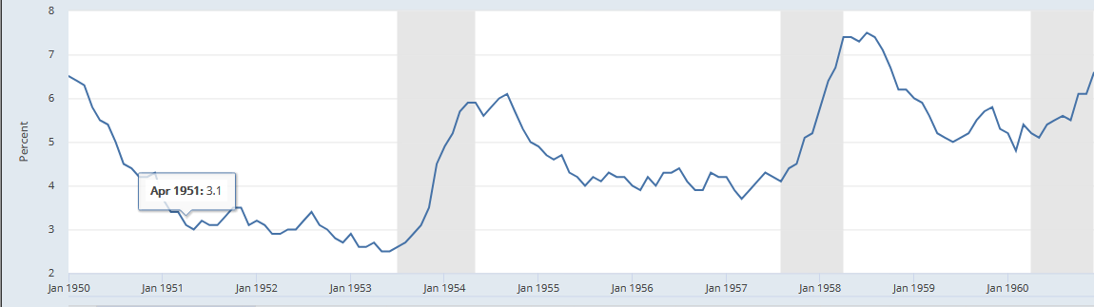
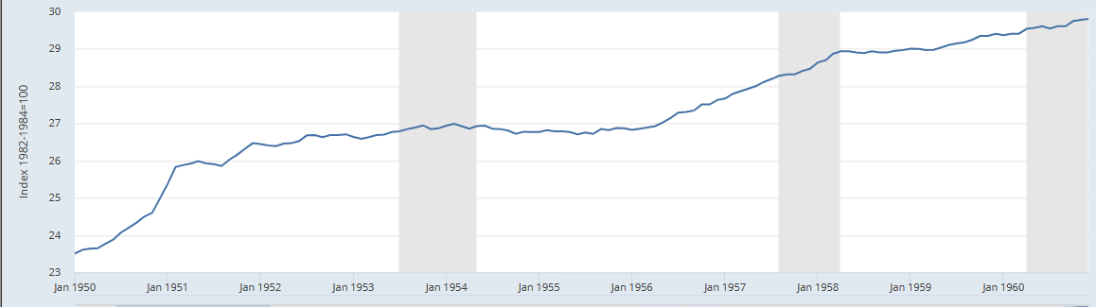
Unemployment and Inflation (2+ slides)
      The ‘HAPPY DAYS’ in the 1950s
      General declining rate of unemployment in the decade
      Thriving economy that produced at 67% capacity
      INFLATION
      Changes in price levels in an year
      Measured using two approached
      Consumer Price Index (CPI)
      Producer Price Index
      CPI=(Expenditures this year÷expenditure in base-year)*100%
      Increasing CPI trajectory
      Expansionary Fiscal Policies
      The thrift culture among the consumers because of high employment and surplus money in circulation
Unemployment in 1950-1960
Inflation Rate in 1950-1960
Rising CPI in 1950-1960
Notes:
Besides GDP, inflation is another reliable indicator of the quality of life among the citizens because it outlines the changes in the price levels from one year to another. There are two methods used to compute the rate of inflation in an economy, which include a Consumer Price Index (CPI) and Producer Price Index. The former approach is the common methodology because it indicate the cost to purchase the basket of goods this year. Further, an economist can trace the inflation rates by comparing consecutive CPIs. A CPI can be computed as the percentage of the current expenditure to the base-year expenditure.
CPI= (Expenditures this year ÷ expenditure in base-year)*100%
Alternatively, Unemployment Rate is a critical factor that influence the growth and quality of work because it reveals the level of joblessness in a country. Increased unemployment rate has adverse effects in an economy because it demoralizes the unemployed individuals, contributed toward degradation of the sets of skills available, and minimizes the purchasing power.
Unemployment Rate=(Number of the unemployed/ total labor force)x100%
The Post World War 2 impacted the U.S. economy because of the reduced production, which subsequently increased the Unemployment Rate to 6.3% in 1950. However, effective fiscal and monetary policies that include increased government spending, low tax regimes, and changes in interest rates helped to stimulate economic recovery. Increased government spending boost the production in an economy because of the high consumers’ spending power that facilitates emergence of new industries and product to cater for the increased demand.

Slide 5
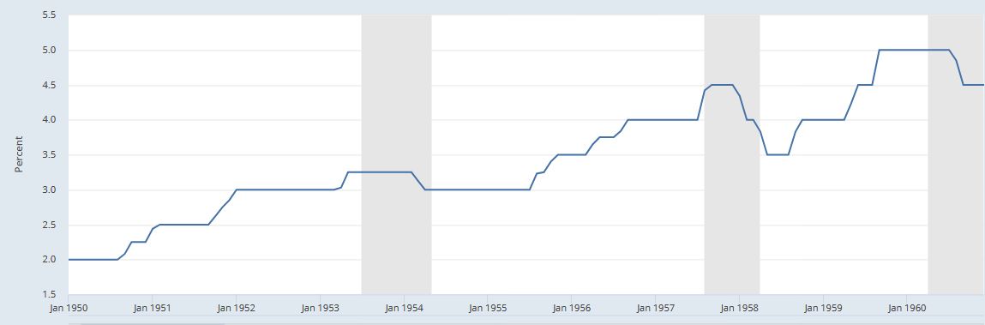
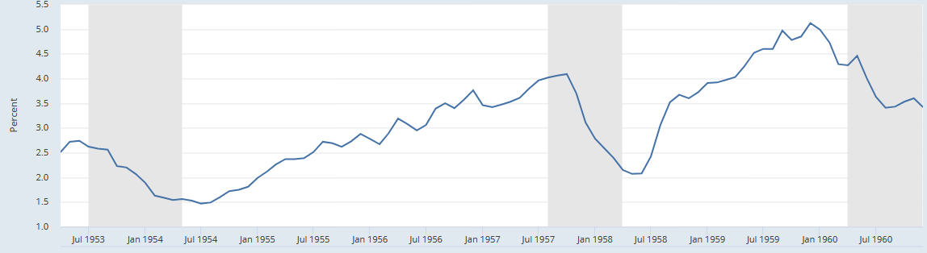
Interest Rates
Prime Bank Loan Rate
3-Year Treasury Rate
  Fluctuation of the interest rates reveals prevailing monetary policies used to:
  improve GDP Output,
  Increase productivity
  Regulate the demand for money
  Interest rates affect the aggregate demand components of national income
  Figure on the Left reveals the trends in Lending rate and discount rate
  Evidently, an increase in interest rate helps to harness the GDP output because
  Rises the value of imports
  Encourage currency devaluation
  Rising lending rate encourages saving in a closed economy
Notes:
The interest rates represent the prevailing cost of capital in an economy, which influence the decisions to consumer, invest, or save. The consumption, saving, and investment represent the aggregate demand components in a closed economy. Notably, low interest rates provide an impetus to consume or invest because of the high returns. Consumptions and Investment decisions hinge on the guaranteed levels of returns. Alternatively, high interest rate can attract foreign direct investment because it allows foreign investors return on their investment in the U.S. economy. Therefore, the fluctuation of the interest rate helps to arrest escalating inflation using open-market operations. Notably, high interest rates facilitate the Federal Reserve to minimize the demand for money in an economy because it rises the cost of loan from the commercial banks. The domestic investors are discouraged from taking expensive commercial loans and reduce the overall circulation of the money.
similarly, the interest rate are integral toward increasing the GDP growth in an economy.

Slide 6
Foreign Trade: Imports and Exports
Competitive economies strive for a balanced foreign trade by undertaking innovations to harness the quality and attractiveness of its export
The U.S. has recorded a continuous increases in real export and export
In 1960,the real Import rose to $139.21B
1951, the Real Import was at the lowest point $74B because of collapsed European market and other global market pressure
The decade was characterized by heightened ‘Proxy Wars’ and subsequent Cold War Phenomenon
Alternatively, the Real Export rose to $139.20B in 1960, the highest in the decade
1950 had the least Real Export output of $66.66B in 1950
Notes:
The foreign trade provides an opportunity to gain competitiveness because it provides cheaper alternative goods, technologies, and expand the demand for the domestic products. The competitive economies strives to achieve a balanced foreign trade by encouraging innovation and efficiency to boost the competitiveness of the import goods in an economy. The U.S. has taken adequate measures to achieve a balance in the export outflow and import inflow in the economy. The total import in 1951 rose to $86.97B from $66.86B in 1950 because deficit foreign trade. The negative effects of the World War 2 forced the government to engage in rationing, which reduce the quantity available to facilitate foreign trade. However, effective stimulus policies that include increased government spending, strong labor unions, and technological advancement enhanced productivity, which improved the real value of the Import to $139.21B in 1960.

Slide 7
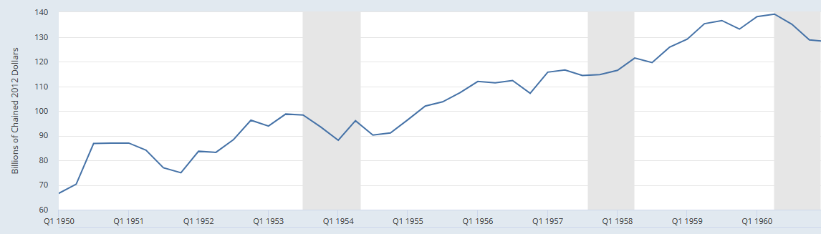
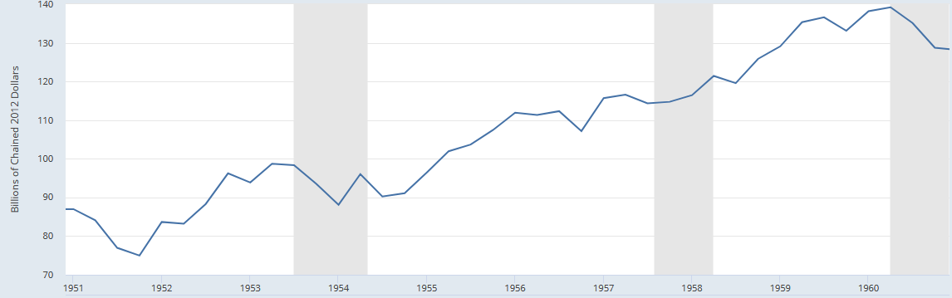
Foreign Trade: Models
The U.S. has similar real export and Import trends
The export and import has continuously risen because of the increased government spending, consumptions, and attractive fiscal policies
Rise in Treasury Lending to 2.25% in 1951
Drop in the export to $74.96 billion in 1951
The bank rates and treasury rates sustain an expansionary strategies in an economy
Evidently, a stable bank interest rate reduces the cost of capital for the investors
The ease of access to capital funds boosts investments that creates surplus export
Alternatively, low treasury rates result in a devaluation of the U.S. Dollar that makes imports less expensive
Further, the company continues to harness innovation and technology advancement that reduce the cost of producing exports favorable
Notes:
Overall, the U.S. is the leading importer and exporter because of the advanced in technology, innovation, and service-intensive economic model. Figure above depict the trends in the real import and export since 1950 to 1960 respectively. Overall, the country has a balance foreign trade because of near-identical real value of export and import. However, the distinctive trend relates to the negative export pattern experienced in 1950 vis-à-vis the increased import value. The decline in value of the real export relates to the dwindling economies in the other region, especially the European region. The post War period adversely affected the European market compared to the United States. Therefore, the U.S. capitalized on the deficit in global market to export the surplus productions.
The ditch in real export and import apparent in the 1954 further demonstrate the negative effects of the escalating proxy wars (Cold War Phenomenon) and over-expansionary fiscal policies. The lagging economic growth forced President Eisenhower to invoke the Congress to minimize the government spending and arrest the inflationary stresses (mild recession)

Slide 8
Fiscal Policy
Expansionary Fiscal Policy Plan in 1950s
Since the Great Depression in 1930s, the level of the U.S. government spending has increased significantly
Models used:
Increased taxation
Strong Labor Unions
increased government interference
The period was relatively stable except for the initial years because of the post World War and Korean War in 1950s
The expansionary fiscal policies were effective because of the high growth recorded in the 1960s
Notes:
The U.S. government hinges on taxation and budgetary strategies to enhance economic growth. The use of fiscal policies gained traction in 1930s, which allowed the economy to spur recovery in the wake of the Great Depression. The U.S. has elaborate fiscal policy formulation that entails cooperation between the Legislative and Executive arms of the government to determine the level of appropriation and taxation. Consequently, the government resolved to utilize the fiscal interventions to mitigate the effects of post War recession and Korean proxy warfare. Evidently, the emergence of the mild recession in 1954 because of an overambitious Eisenhower’s Middle Way Stimulus programs. The president resolved to initiate a legislative power by using the Congress to curb government spending and contract the fiscal interventions.

Slide 9
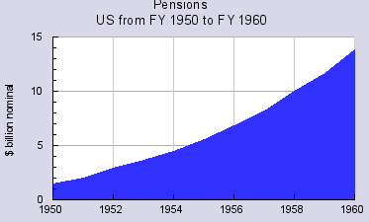
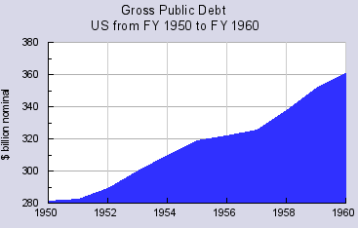
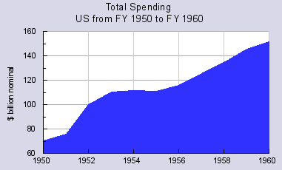
Fiscal Policy Actions
Welfare Spending trends
Perce
Gross Public Debt
Total Government Spending
The decade benefited from the expansionary fiscal strategies
1950 was characterized by inflationary pressure
Government reacted by increasing the expenditure and reducing the taxation to facilitate economic recovery
The total government spending in 1950 was $75B
Compared to $100B in 1952
To sustain the spending habit, the government increased the amount of borrowing
Notes:
Evidently, the decade has apparent sustained expansionary fiscal spending that harness the general welfare, spur economic recovery, and improve the national security. The expansionary fiscal spending aimed to harness the general welfare, spur economic recovery, and improve the national security. Notably, the defense spending increased in 1952 because of the proxy warfare that spread across the regions. Importantly, the expansionary fiscal strategies elicited significant criticisms because of the galloping Gross Public Debt that were used to cater for the increased consumption and investment components in the economy. Evidently, the Gross Public Debt in 1950 was $280B but rose to $360B in 1960.

Slide 10
Fiscal Policy Impact
Eisenhower’s economic stimulus policies had positive outcomes
A key positive effect of the expansionary policies relate to the increment in the Real Exports in subsequent years after 1952.
Positive effects of increased government spending include;-
Drop in Unemployment Rate to 2.9% in 1952
Emergency of new industries
CPI rose to 26.5 in 1952 from 23.5 in 1950
Real GDP output rose to $2423B in 1952
Real export rose to $83.66B in 1952
Real import rose to $74.96B in 1952
Notes:
Eisenhower’s economic stimulus policies had positive outcomes, which led to characterization of the decade as a “HAPPY DAY”. Reduced unemployment because of the increased government spending to harness the welfare and alleviate the negative inflationary stress after the post World War period. Eisenhower’s Middle Way economic approach had steered a balanced economic progression because it sustained the New Deal Plan by increasing the government spending on Social Security to harness the welfare. Further, Eisenhower’s fiscal strategies focused on implementation of large projects to create more job opportunities and spur production in the long-run. Consequently, increased spending led to the rise of consumerism prosperity in 1950s.

Slide 11
Monetary Policy
Liquidity actions taken to respond to financial stress include;-
Discount Rate,
Increases in prime bank-loan Rates (Reserve Requirements)
Federal Funds Rates (Discount Rate)
Increases in price levels forces the Federal Reserve to increase the money supply by lowering the short-term interest rates
Conversely, a constricting economic growth forces the Federal Reserve to increase the interest rate using the Open-Market Operations (OMO)
Notes:
The Federal reserves utilizes the Open-Market Operation, Discount Policy, and Reserve Requirements to control the money circulation in an economy. Evidently, the Federal Reserve in 1950 responded promptly using the liquidity actions by reducing the discount rate and increasing the prime bank-loan rate in the subsequent periods. The rapid escalation of the inflation requires that the Federal Reserve reduces the money supply by raising the short-term interest rate from 2.25% in 1950 to 2.50% in 1952. Alternatively, the OMO tool is the most effective intervention to maintain the changes in the inflation rate because it involves selling or buying the treasury securities to control the amount of money in the circulation. The high circulation of the money in the economy necessitates the Federal Reserve to issue the treasary treasury securities and minimize the amount of circulation.

Slide 12
Monetary Policy Actions
Since 1970, the U.S. Federal Reserve utilizes the monetary policies to prevent the escalation of the inflation rate.
The Federal Reserve used a contractionary monetary policies to arrest the inflationary pressure in 1950-1952
Initially, the Federal Reserve adopted the liquidity action by cutting the discount rate and extending the term loans to the commercial banks.
The Federal further reduced the Federal Fund rates by 50 basis points
However, the monetary tools failed to yield the expected outcomes because of the continued manifestation of the dysfunctions in the credit market
Notes:
The protracted dysfunctions in the credit markets hampered the effectiveness of the initial liquidity actions taken to arrest the escalating inflationary stresses in 1950 to 1952. Therefore, the Federal Reserve undertook extraordinary actions that include provision of currency-swap agreements, emergency lending facilities, and supporting the credit market to function adequately (Bernanke, 2012). The increasing unemployment rate required the adoption of contractionary monetary polices that include reduction in the interest rate to minimize the availability of the money circulation. The low federal fund rate evidently enhanced the effectiveness because liquidity actions.

Slide 13
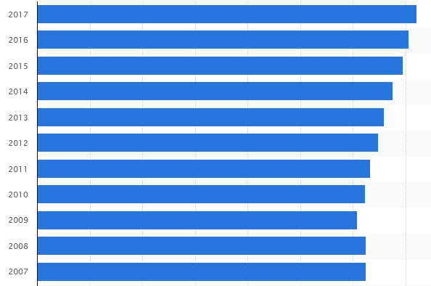
Monetary Policy Impact
GDP trends since 2007
The period between 1950 to 1960 is characterized by a contractionary monetary policies
Contractionary monetary policies aims to reduce the interest rates and minimize the amount of money supply
Notably, the Federal Reserve resolved to reduce the 3-Year Interest Rate, Federal Fund Rate, and Bank-Prime Loan Rate
Evidently, the GDP in subsequent years increased tremendously
Therefore, the growth in GDP indicate efficiency of the decision to reduce the interest rates
Notes:
Overall, the contractionary monetary policies had positive impacts in the long-term. The steady rise in the Real GDP from 1950 to 1960 was a critical benefit of integrating contractionary monetary policies. Specifically, the contractionary monetary policies entailed the reduction of the 3-year interest rate, federal fund rate, and bank-prime loan rate. Further reduction of the Interest rate merited because it facilitated the Federal Bank to reduce the money supply using Open-Market Operations (OMO) to buy out the securities from the economy. Notably, the expansionary fiscal policy led to excess circulation of the money, which facilitate the citizens to invest in security market. Therefore, the a decision to purchase the treasury securities helped to minimize the amount of money in the economy.

Slide 14
Conclusions
Concisely, the period 1950-1960 had distinctive economic outlook because of the sustained economic growth in the post World War and heightened proxy wars
Evidently, the inflationary stress experienced in 1950-1952 emanated from the increased government spending, which aimed to facilitate economic recovery.
The Federal Reserve resolved to utilize expansionary fiscal and monetary policies to arrest the detrimental financial stresses, which hampered the functioning of the credit market.
Overall, the decade is considered a “HAPPY-DAYS” because of the low unemployment rates
However, Eisenhower’s Middle Way policies experienced a lapse in 1954
Notes:
The decade has been characterized by a relative stable state of economy because of effective Eisenhower’s stimulus programs. The mild inflationary stress in the earlier years emanated from the general dwindling global economies. Notably, the devastation of the European Market due to World War 2 and proxy warfare that transformed to the Cold War had adverse effects on the relatively stable economic period. The Federal Reserve resumed the role to arrest further rise in inflation pressure in the economy using the credit-control, discount rate, and open-market operation tools. The use of the monetary tools and expansionary fiscal plans yielded positive and negative outcomes. First, increased government spending yielded short-term outcomes because it improved the production capacity, increased spending power, and high employment rate. However, in 1954, the economy witnessed a lagging economy because of poor productivity.

Slide 15
“Agreement”
The calibers of fiscal and monetary policies taken to mitigate the inflationary stresses in 1950-1952 were effective
The key fiscal policy adopted relates to increased government spending to reduce the unemployment
The expansionary fiscal policy merits in the short-run because it facilitates job-creation because firms operate above the normal capacity
However, the sustained adoption of expansionary fiscal policy had long-term drawbacks because it increases the inflation rate
The surging CPI trends manifest the dire effect of increased government spending in an economy
On the other hand, the contraction monetary policy has benefited the U.S. economy in the short-run and in the long-run
Specifically, the strategy to reduce the Federal Fund Rate, Discount Rate, and Bank Loan Rate helped to constrict the excess money supply in the economy
Notes:
Overall, the calibers of expansionary fiscal policy and contractionary monetary policies had positive short-term benefits to the U.S. economy because it helped to alleviate the adverse effects of prevailing financial stresses. Notably, the Federal Reserve resolved to employ an expansionary fiscal strategy to increase the level of government spending on education, welfare, defense, and transfer schemes. Increased government spending results in the high circulation of the money in an economy and facilitate the economic agencies to produce above their normal capacities (Melvin & Norrbin, 2013). Consequently, when firms produces above the normal capacity, there is a demand for additional labor forces to cater for the new demands. Therefore, the new demand for labor forces reduces the unemployment rate in the economy in the short-run.
However, in the long-term, increased government spending creates an inflationary deficit in the economy because of excess supply of the money in an economy. The U.S. government continues to increase the money supply in the economy during a financial recession to address the unemployment rate and gain political supports. The notable schemes that the government address include defense, education, pensions, and healthcare, which have direct impact on the livelihood of the citizens. Therefore, increased money circulation results in an inflation because of the rise in the Consumer Price Index (CPI). Besides, the CPI trends in the decade reveals a general decline in 2007, 2008, and 2009 because of the reduced money circulation. The decision to increase the money circulation rose the CPI to $26.52 in 1952 from $23.50 in 1950. The increases in the CPI trend manifests the negative influence of the continuous expansionary fiscal policy.
On the other hand, the cadre of fiscal policy that aimed to reduce the surplus circulation of the money in an economy (inflationary stresses) was an ideal model to alleviate the long-term limitations of the fiscal policy. Specifically, the Federal Reserve opted to reduce the Federal Fund Rate, Discount Rate, and Prime Bank Loan Rate to yield positive outcomes. Further reduction of the Interest rate merited because it facilitated the Federal Bank to reduce the money supply using Open-Market Operations (OMO) to buy out the securities from the economy. Notably, the expansionary fiscal policy led to excess circulation of the money, which facilitate the citizens to invest in security market. Therefore, the a decision to purchase the treasury securities helped to minimize the amount of money in the economy.

Slide 16
References
Bernanke, B. (August 2012). Monetary policy since the onset of the crisis, Wyoming: Federal Reserve Bank of Kansas City
Chantrill,C. (2017). “U.S. government spending in recent decades,” The US-governmentspending.com. Retrieved from www.usgovernmentspending.com/recent_spending
Melvin, M., & Norrbin, S. (2013). International money and finance, Oxford Univerisy Press
Academic Press U.S. Bureau of Labor Statistics, Civilian Unemployment Rate [UNRATE], retrieved from FRED, Federal Reserve Bank of St. Louis; https://fred.stlouisfed.org/series/UNRATE, December 15, 2018.
.

